Slide 1
House Loan Approval
Haripriya Sivaramakrishnan

Slide 2
Crisp-DM Framework
Standard Process for Data Mining describes an idealized sequence of events
Business Understanding
What is the end goal from a business perspective
Data Understanding
Acquire and integrate data from various sources. Explore Data and assess its quality
Data Preparation
Construct dataset using relevant data from acquired raw data
Notes:
1. Determining the contigencies, risk assesment, resources and succession critera from business point of view to understand the various factors that could potentially impact the outcome.
2. Explore the different attributes and the relationship they have with each other. Figure out possible outliers
3. Clean the data to improve its quality. Create dataset using derived attributes or generating records to fill in any gaps.
4. Test model's quality and validity.
5. Evaluate efficiency of Models and the actions to be taken based on the results
6.

Slide 3
Modelling
Model the dataset after generating test design
Evaluation
Evaluate if model satisfies the specified business objectives
Deployment
A generated report or deployable code mechanism that works on unseen data

Slide 4
Problem Statement
For this project:
Predicting House Loan Eligibility
Why is this Problem Important?
Banks make profit from the interest only when the borrower pays off the loan. The goal is to predict if the borrower will repay the loan by its maturity date or not. Thereby Minimizing the Risk of Loan Payment Default.
Looking into the borrower's personal information allows banks to Mitigate Fraud Risk
Notes:
Generraly the Eligibility Criteria are:
Credit score
Current income
Employment history
Equated monthly installment
Repayment history

Slide 5
Sampling Methods
Sampling Methods
Probability
Simple Random
Systematic
Stratified
Cluster
Non Probability
Conven
-ience
Purposive
Snowball
Voluntary Response
Used to Create an ideal representation of the population as a whole for feasible analysis on large population set.
Notes:
Generraly the Eligibility Criteria are:
Credit score
Current income
Employment history
Equated monthly installment
Repayment history

Slide 6
Probability Sampling Methods
 | Simple Random | Systematic | Stratified | Cluster
Description | Each element is chosen by chance. Each member has equal chance of being selected | Elements are selected at regular intervals from sampling data | Population divided into subgroups who have some characteristic similarity | Subgroups (usually predefinied clusters) are used as sampling unit
Pros | Most straightforward | Easy to administer | Reduces sample bias | Efficiency with large and Dispersed Population
Cons | Selection of appropriate no of individuals to create a well distributed sample | Risk of bias if underlying pattern is present | Requires knowledge of appropriate characteristic and choosing the characteristic(s) to stratify by | Increased Risk of Bias and Sampling Error
Notes:
Generraly the Eligibility Criteria are:
Credit score
Current income
Employment history
Equated monthly installment
Repayment history

Slide 7
Variable Description:
Variable | Description
Loan_ID | Unique Loan ID
Gender | Male/ Female
Married | Applicant Married (Y/N)
Dependents | Number of Dependents
Education | Apllicant Education
Self_Employed | Self Employed (Y/N)
ApplicantIncome | Applicant Income
CoapplicantIncome | Coapplicant Income
LoanAmount | Loan amount in thousands
Loan_Amount_Term | Term of loan in months
Credit_History | Credit HistoryMeets Guidelines (Y/N)
Property_Area | Urban/ Semi Urban/ Rural
Loan_Status | Loan approved (Y/N)

Slide 8
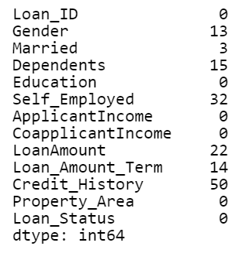
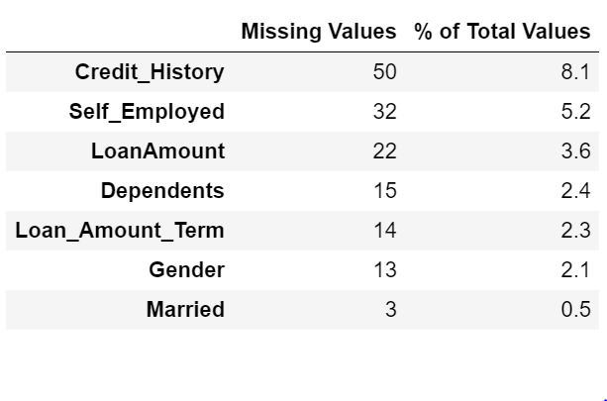
Summary of Missing Values:
Table Showing count of Missing Data
Table Showing what Percentage of Total Data is missing in that particular Column

Slide 9
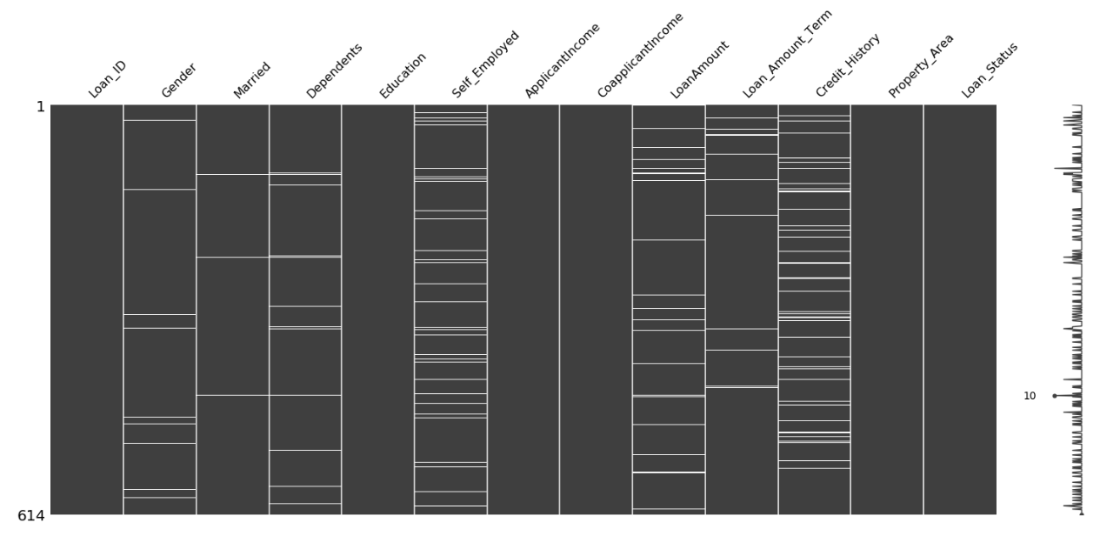
Visualizing Missing Data:
Key: The white lines indicate missing data in that particular column and the row in which Data is missing

Slide 10
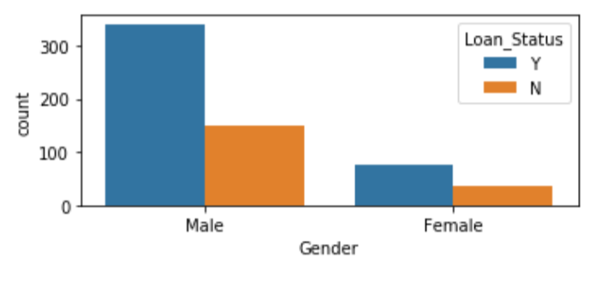
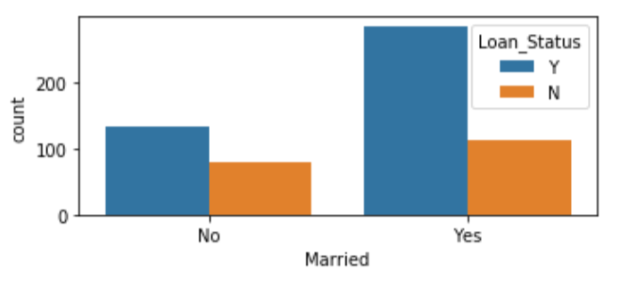
Data Analysis through Visualization
The data set was Male Dominated and Male had 2.37% higher approval rate as compared to female
The data set contained more Married individuals and Married individual had 65% approval rate compared to 34% for Unmarried individuals

Slide 11
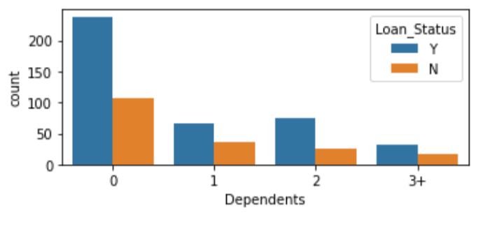
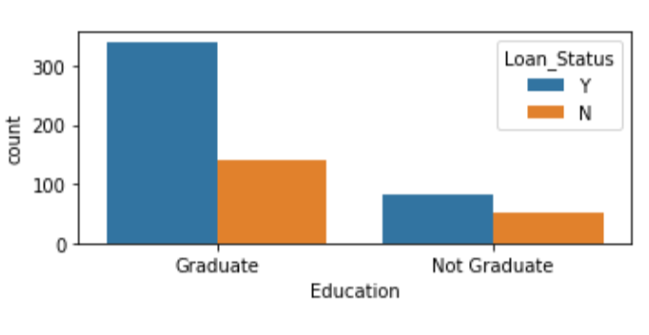
Data Analysis through Visualization contd.
The dataset had higher percentage of individuals with 0 dependents. But Individuals with 2 dependents had 75% approval rate as compared to the 68% rate for 0 dependents
The dataset had higher percentage of graduates. A Graduate had 78% approval rate whereas a Non-Graduate had only 21% approval rate.

Slide 12
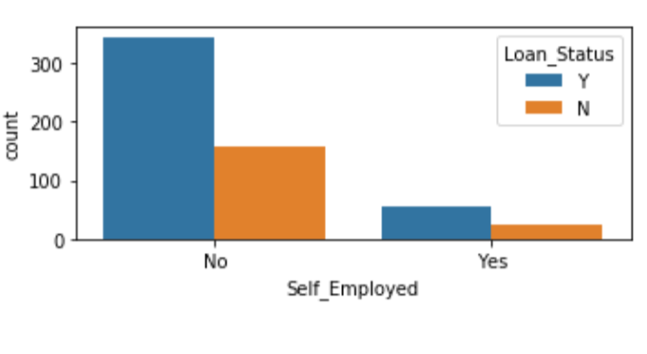
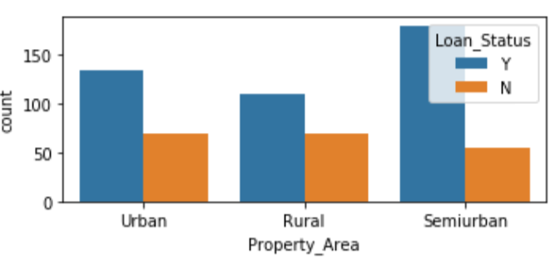
Data Analysis through Visualization contd.
The data set had lower number of Self Employed individuals and Non-Self Employed person had 85.9% higher approval rate as compared to Self Employed Individual
The dataset was dominated by SemiUrban Locality and had 37.9% approval rate as compared to 32.8% for Urban and 29% for Rural Locality

Slide 13
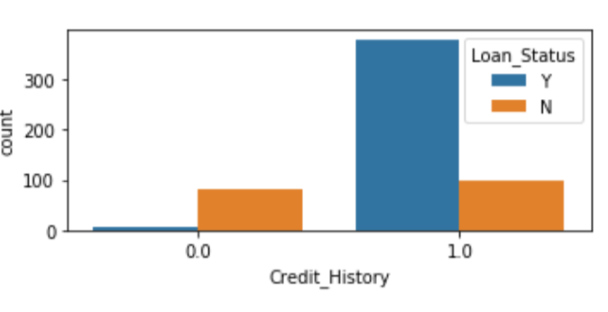
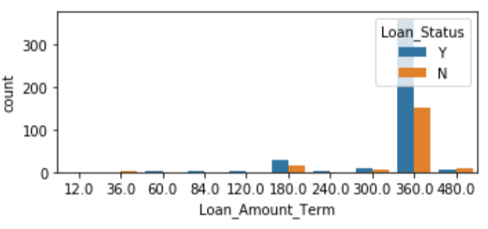
Data Analysis through Visualization contd.
The data set shows individuals with good Credit History have higher approval rate of 84.2%. Negative Credit History has higher chance of getting denied.
The data set shows Loan Amount Term has wide range and the most common House Loan Term is 360 months

Slide 14
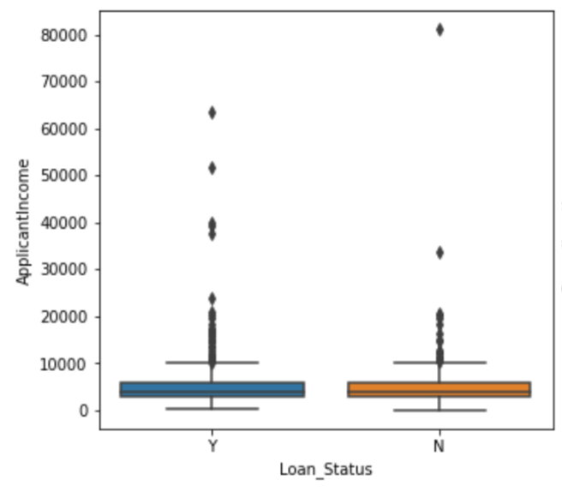
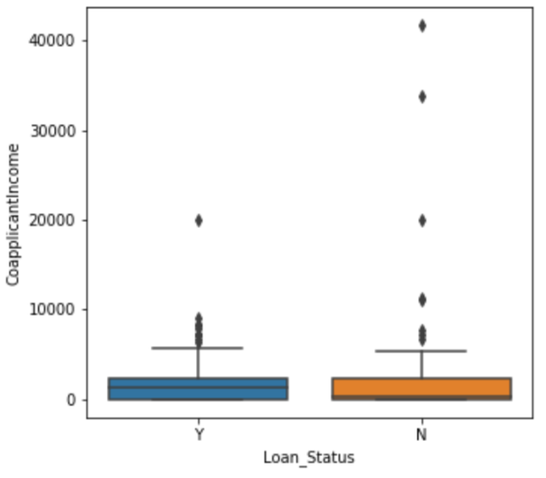
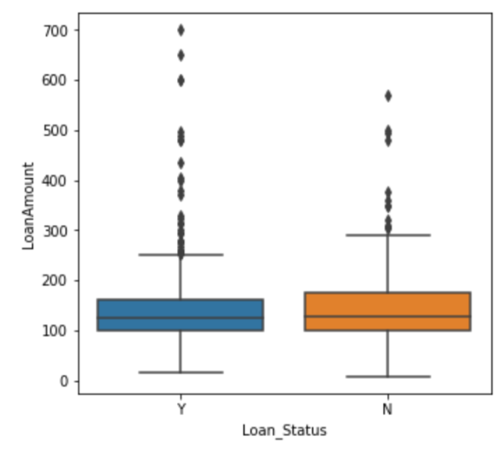
Data Analysis through Visualization contd.
The graph indicates that there is no direct relation between Loan Approval Status and the Applicat Income, Coapplicant Income or Loan Amount. The range indicates the income disparity in the society. The boxplot also confirms the presence of lot of outlier/extreme values.

Slide 15
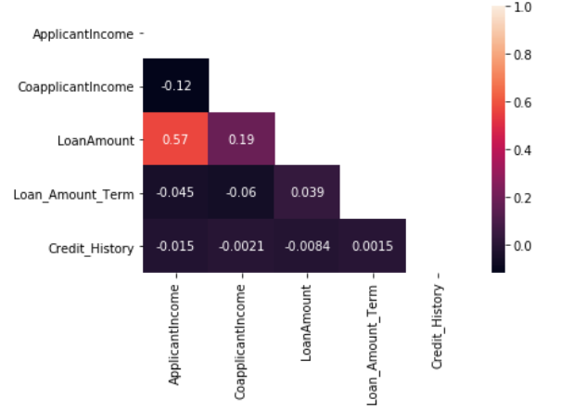
Data Analysis through Visualization contd.
Posive Value indicates a positive correlation. From heatmap it's clear that Applicant Income and Loan Amount have positive correlation and similarily Coapplicant Income and Loan Amount.

Slide 16
Classification Report
Precision Score
Ability of model to not predict predict an instance positive when is it actually negative. That is ensuring for all the instances classified as positive, what percent was correct.
Recall Score
Ability of model to find all positive instances. Measure of for all instances that are positive what percent was classified correctly.
F1 Score
Ability to judge efficiency of model when either precision or recall is high and the other one in low. Especially useful when dealing with imbalanced data.

Slide 17
Imbalanced Data
With Imbalanced Data the majority classes dominate over the minority classes. Therefore the algorithim is biased towards the majority classes. hence there is poor classification of minority classes.
Some Real world example of imbalanced data are fraud detction and oil spill detection and so on.
Some techniques are used in the preprocessing stage such as oversampling, undersampling and Resampling

Slide 18
What I have learnt:
I had the opportunity to apply the theoretical concepts and explore the different python libraries used in data science. i also explored how other data science problems can be handled. The different ways to explore data and the handling data quality issues
I was able to familiarise myself with working to meet deadlines and documentation of code and results in a presentable and coherent manner.
Tools/Techniques: Python (libraries : scikitlearn, matplotlib, seaborn, numpy, pandas, so on), Logistic Regression Model, Evaluation Metrics, Statistic Analysis

Slide 19
Thank You

